Slide 1
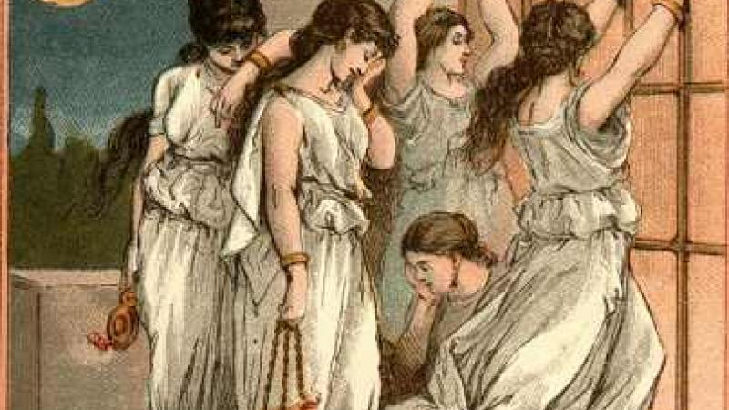
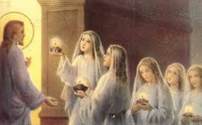
The Parable of Ten Virgins
The Parable that was told by Lord Jesus about the Kingdom of Heaven
Five Foolish Virgins
Five Wise Virgins

Slide 2
Can there be foolish Virgins in Kingdom of Heaven?
YES

Slide 3
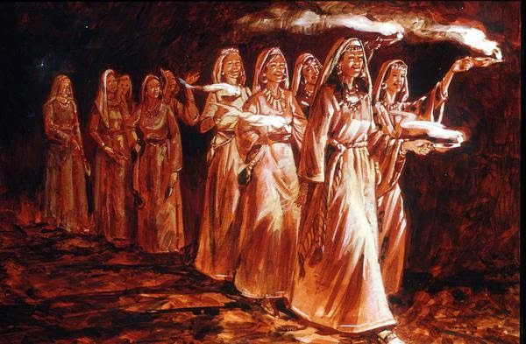
Wise virgins representing the Bride church.
Foolish virgins representing the Universal church.

Slide 4
SIMILARITIES
They are all Virgins
Virgin is the one who was made pure and perfect in the blood of Christ.
Virgin is the one who was betrothed to one husband i.e. Christ ( II COR 11:23).
Virgin is the one that was set out to meet the Bridegroom

Slide 5
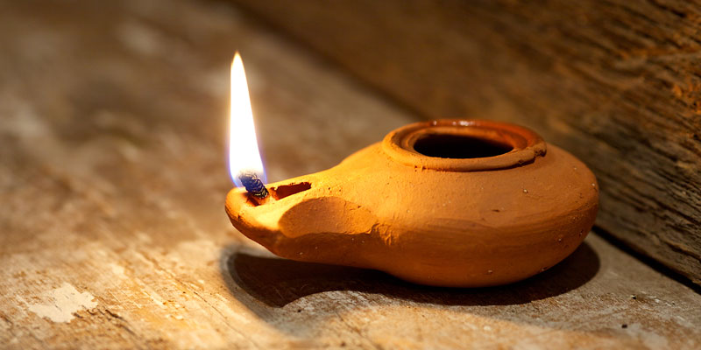
2) They all carry lamps
a) Lamp is the light of the Spirit, the light of Salvation
b) The spirit of man is the lamp of the lord (PROV.20:27)

Slide 6

c) Lamp is the legacy of God (I kings 11:36) .
chosen state, hierarchy promise.
d) Lamp is the ultimate grace of God (II Kings 8:19)

Slide 7

e) Lamp is the glory of God ( Job 29:3 ).
f) Lamp is the word of God ( PS 119.105 ) ; ( Prov 5:3 )

Slide 8
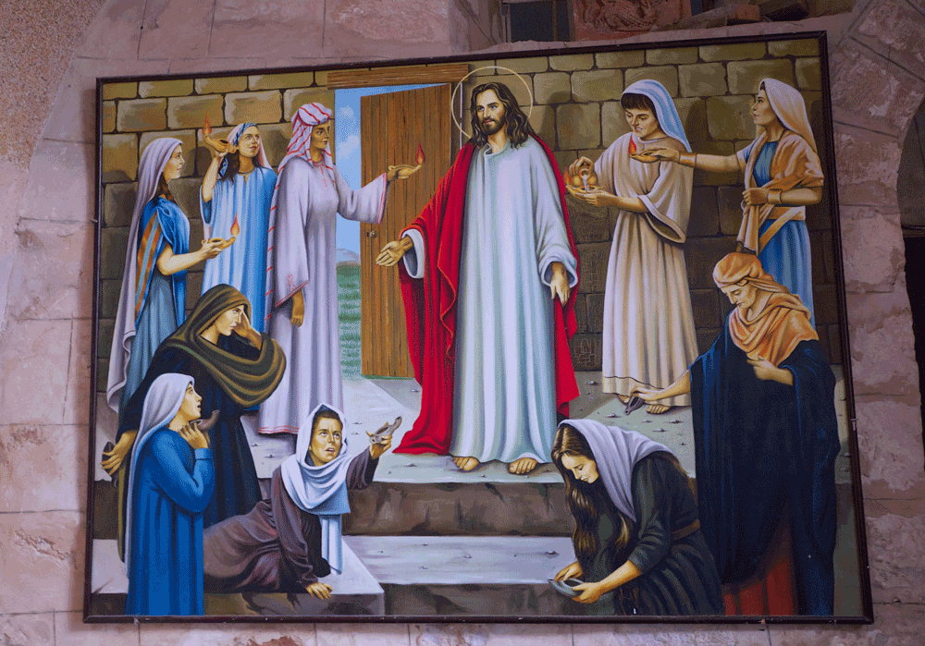
3) They all went out to meet the Bridegroom
They overcome the word
They have no bondages
They are on their rapture Journey
They see Christ as a Bridegroom

Slide 9
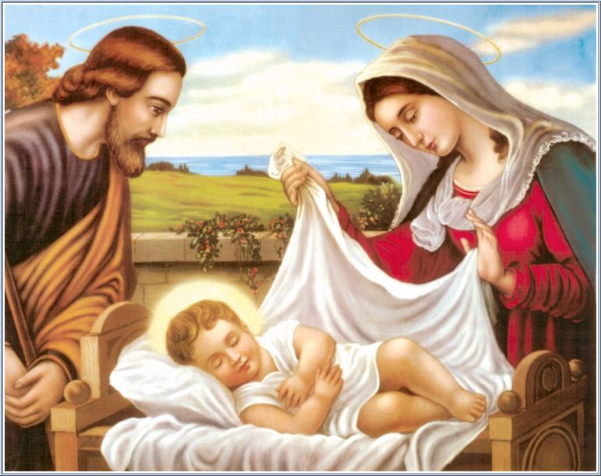
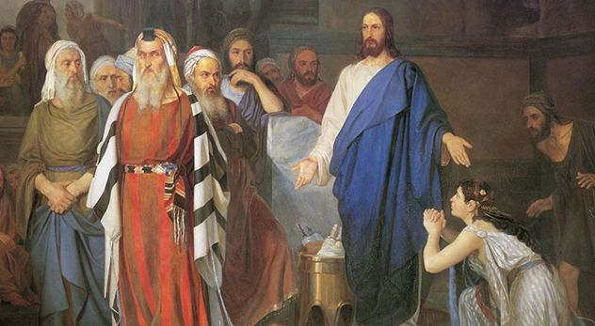
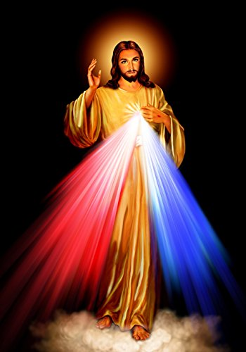
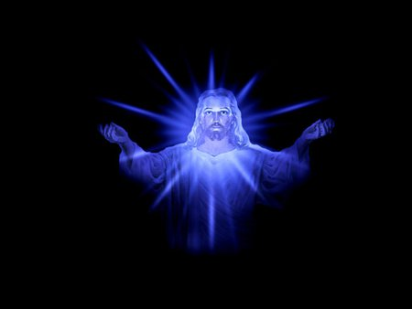
Baby Jesus-Son
Adul Jesus-Son of Man
Divine Jesus-Son of God
Glorious Jesus - Bridegroom

Slide 10
How are you looking at Jesus?
Master
Friend
Saviour
Bridegroom

Slide 11
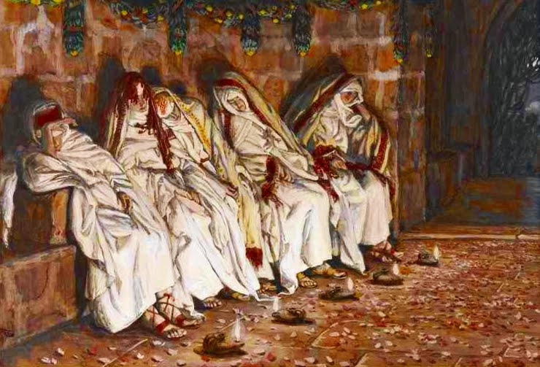
4) They all slumbered and slept
The woes of mid night
The unconditional delay of the bridegroom
The spiritual weaknesses (Mar. 26:40-43)
Unspiritual practice and elements (II Cor. 11:30)

